Slide 1
An introduction to machine learning with R
Laura da Silva
Darshna Shah

Slide 2

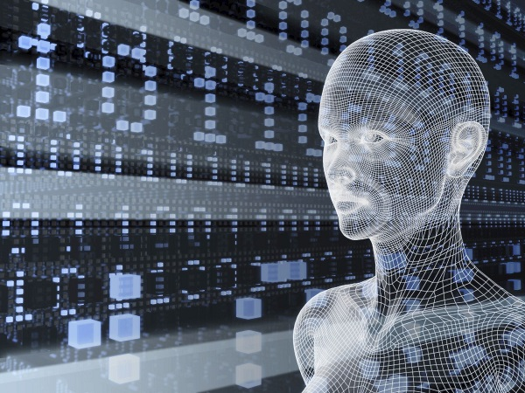
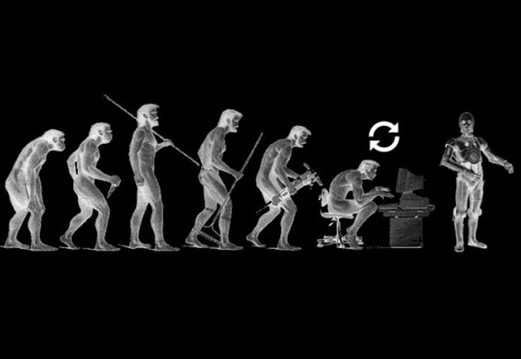
What is machine learning
At a basic level machine learning explores the construction and use of algorithms that can learn from data
Notes:
At a basic level machine learning explores the construction and use of algorithms that can learn from data
We can say a machine learning model is able to learn when its performance improves with additional data

Slide 3
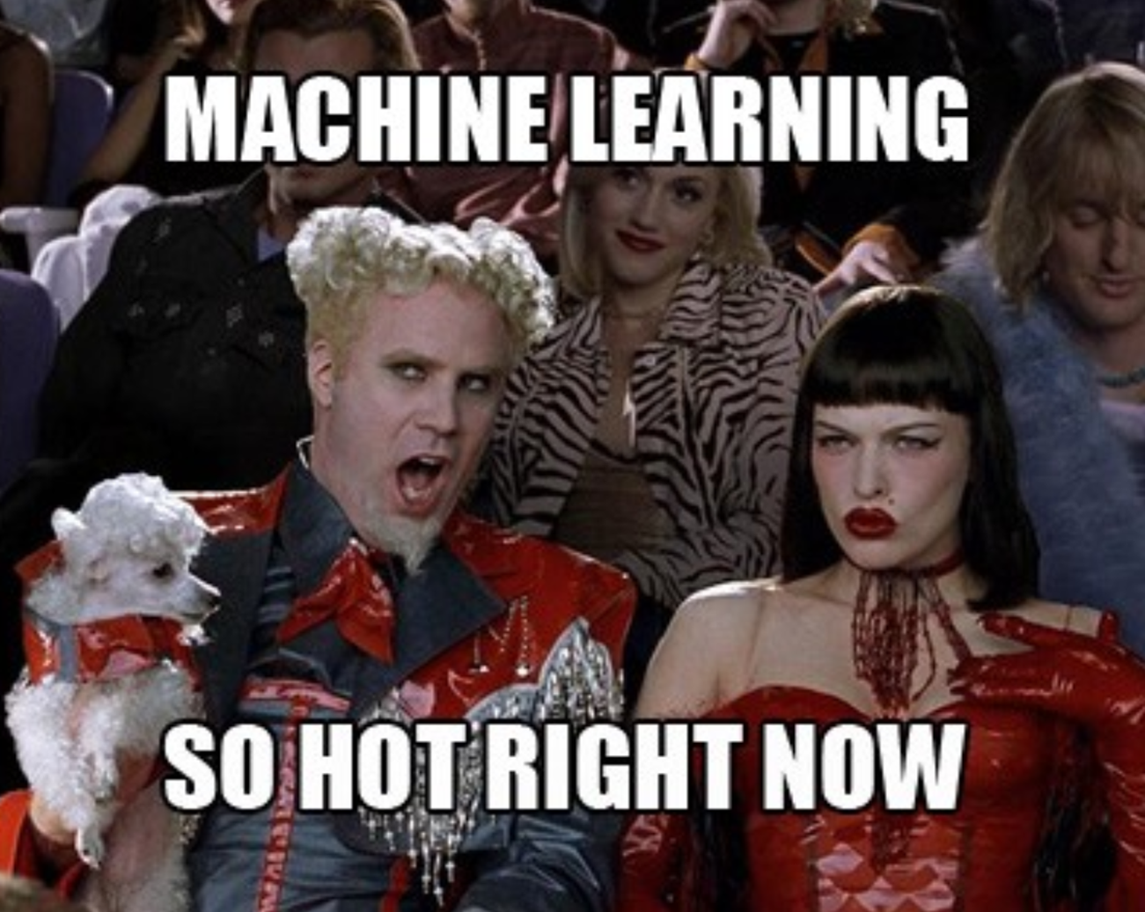

What questions can machine learning answer
Spam detection
Credit card fraud detection
Speech recognition (chat bots)
Product recommendation
Medical diagnosis
Stock trading
Customer segmentation
Self driving cars

Slide 4

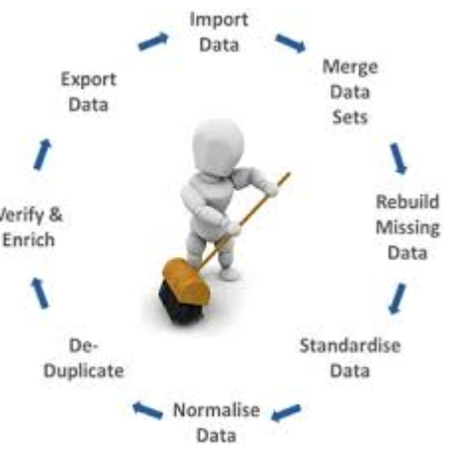
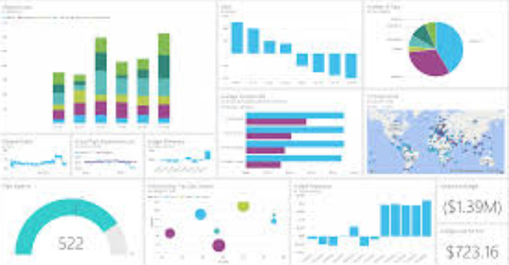
What machine learning is not
Calculating average height of a population
Cleaning data
Most other informative/ exploratory statistics (median, frequency, etc)

Slide 5

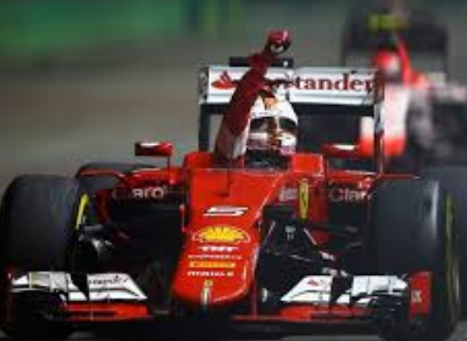
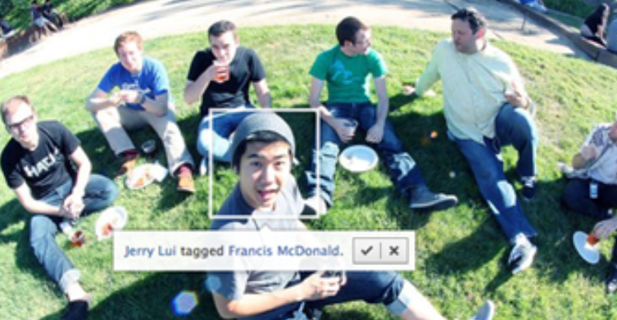

What is machine Learning Exercise
Determine whether an incoming email is spam or not?
Obtain the name of last year’s F1 champion
Automatically tagging your new Facebook photos
Select the student with the highest grade on a statistics course
Notes:
Ask audience to classify which scenarios are examples of machine learning

Slide 6
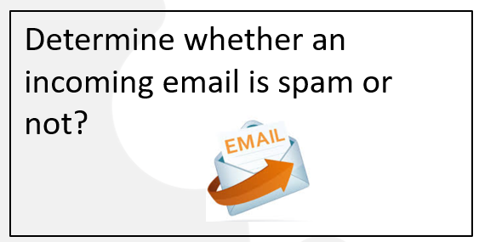
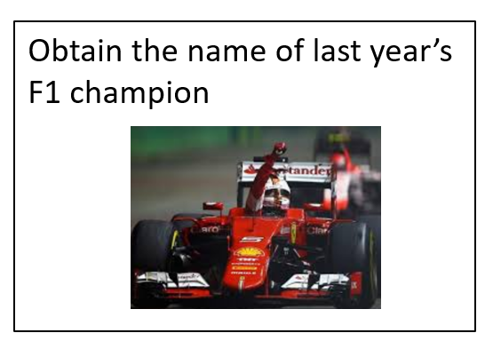
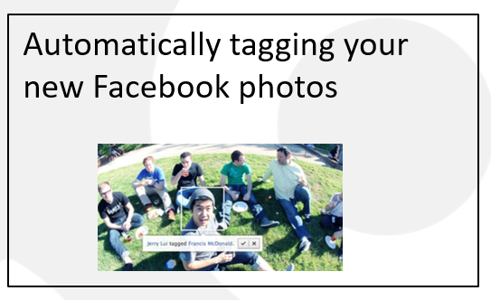
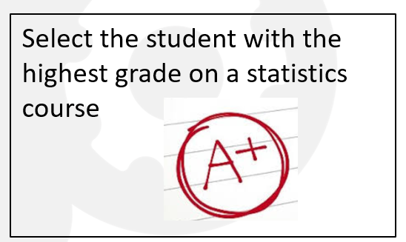
What is machine learning? The answers

Slide 7
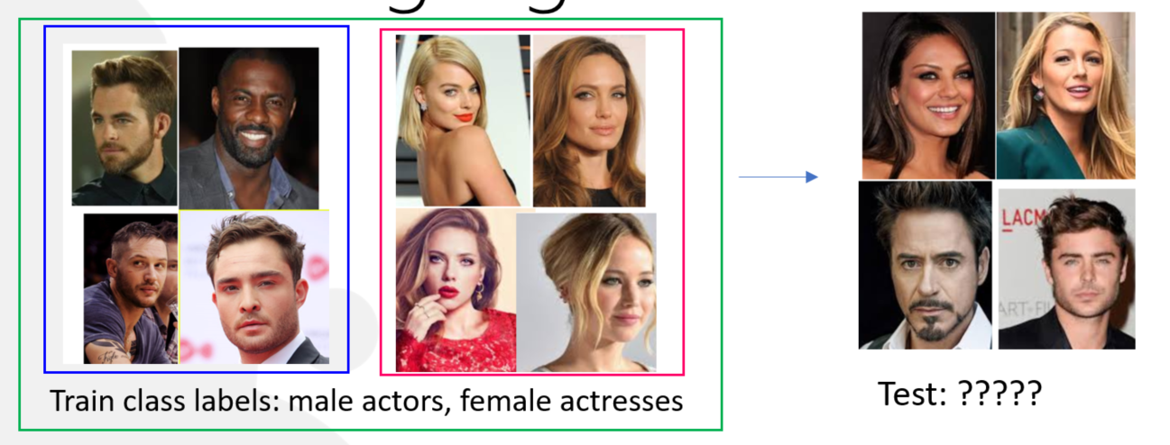
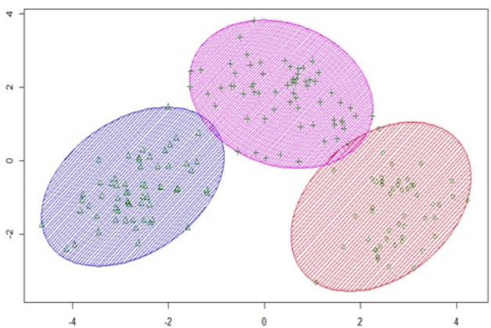

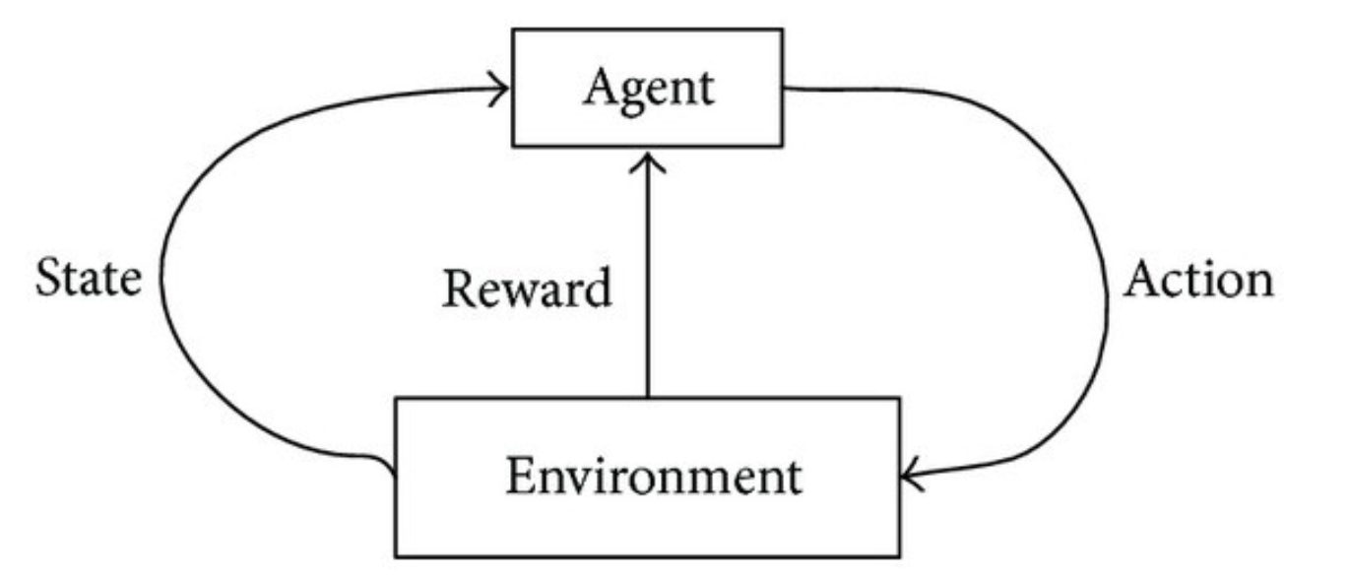
Types of machine learning algorithms
Supervised learning
Unsupervised learning
Reinforcement learning
trains
Boats/ships
planes

Slide 8
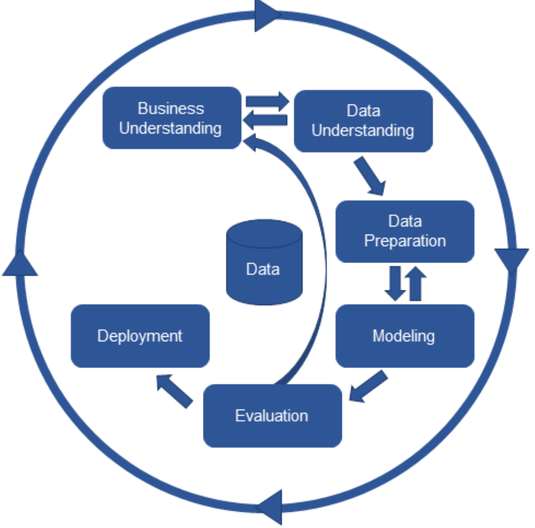
CRISP- DM: developing machine learning models

Slide 9
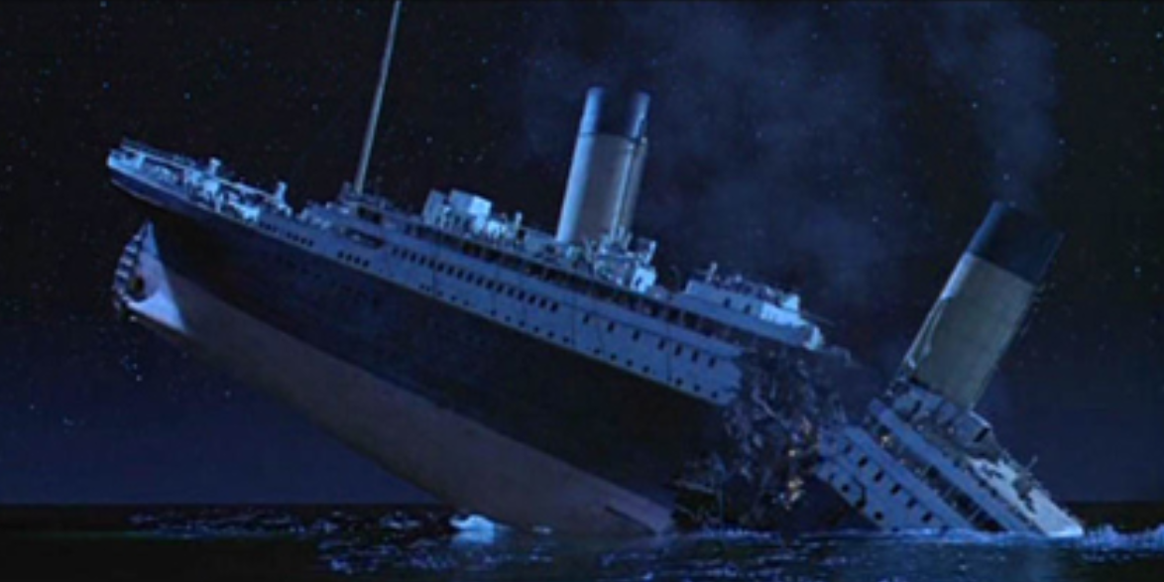
Task: Build a classification model of titanic survivors using the caret package in R!
Notes:
Goal: There are many advanced things that can be done with caret. But out goal today is to give an introduction to machine learning in R using the caret package and get you excited to learn more about machine learning and practising R.
The sinking of the RMS Titanic is one of the most infamous shipwrecks in history. On April 15, 1912, during her maiden voyage, the Titanic sank after colliding with an iceberg, killing 1502 out of 2224 passengers and crew. This sensational tragedy shocked the international community and led to better safety regulations for ships.
One of the reasons that the shipwreck led to such loss of life was that there were not enough lifeboats for the passengers and crew. Although there was some element of luck involved in surviving the sinking, some groups of people were more likely to survive than others, such as women, children, and the upper-class.
In this challenge, we ask you to complete the analysis of what sorts of people were likely to survive. In particular, we ask you to apply the tools of machine learning to predict which passengers survived the tragedy.
CARET == Classification and Regression Training
Caret is written and maintained by Max Kuhn and has become the go to package for ML in R. Provides a common interface where you have access to many ML algorithms. This also provides some consistency in tuning and developing models as opposed to writing functions from scratch

Slide 10
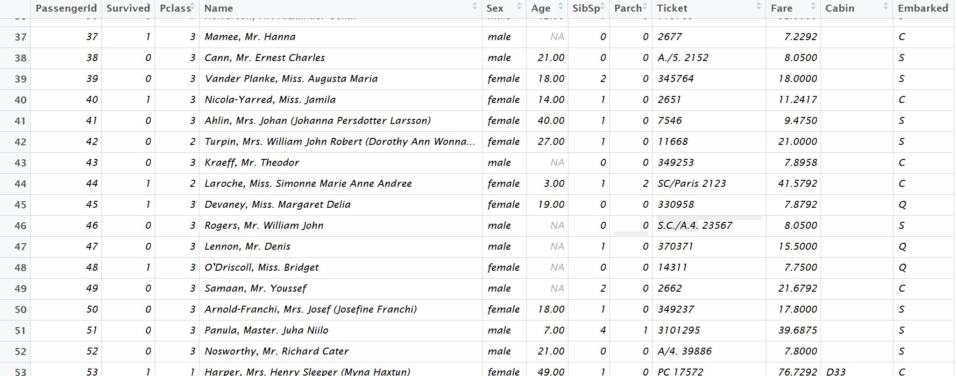
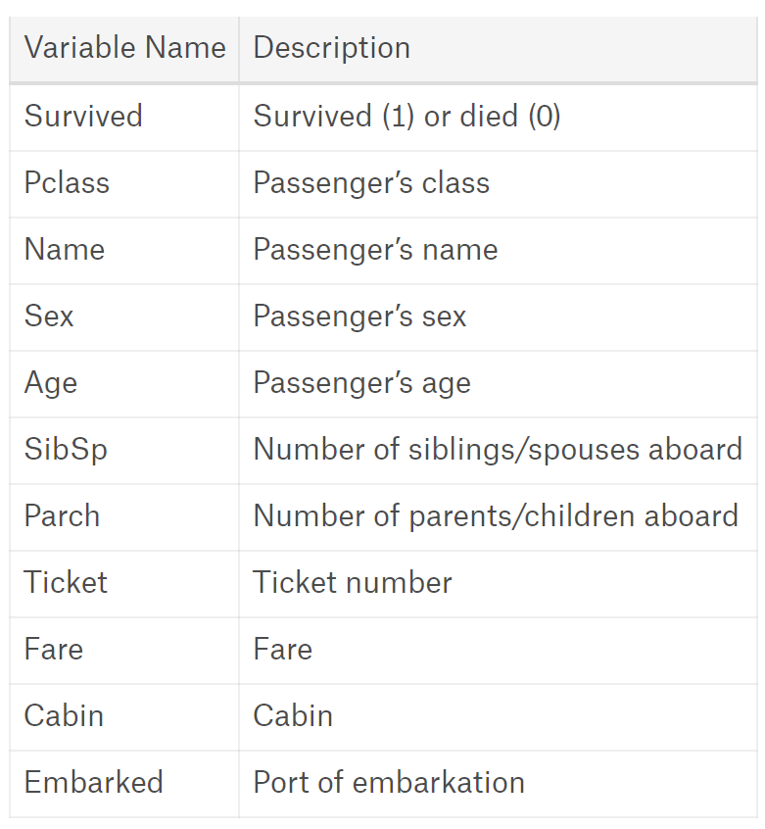
The Data (we will work on the clean version)

Slide 11
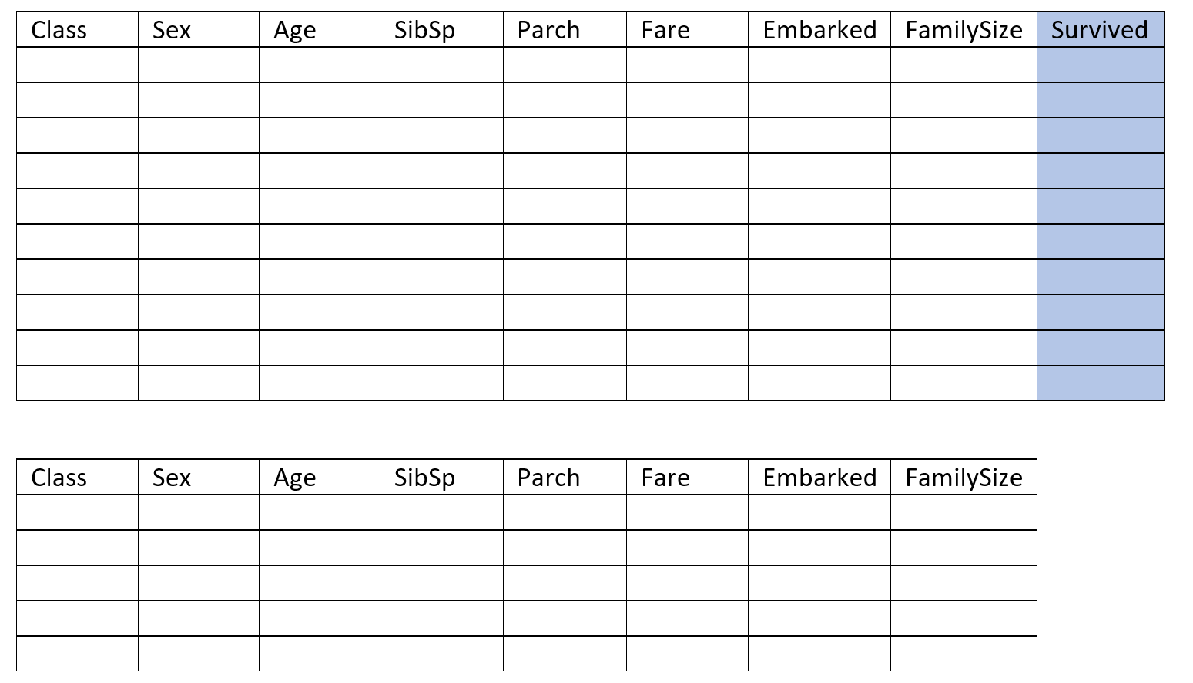
Splitting the data for training and testing
70%
30%

Slide 12
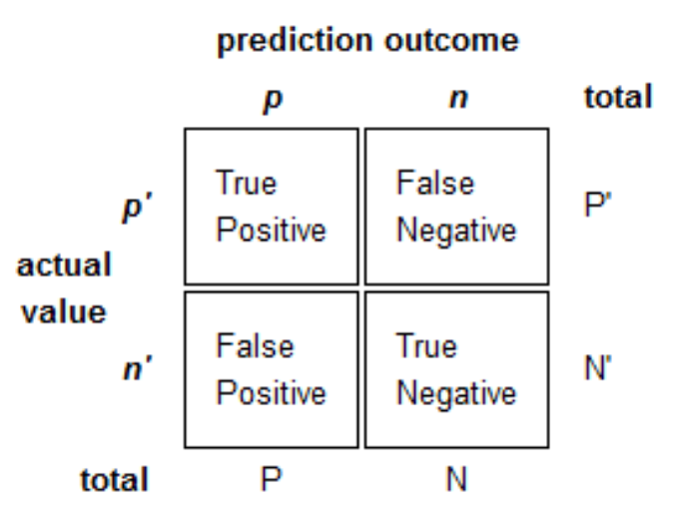
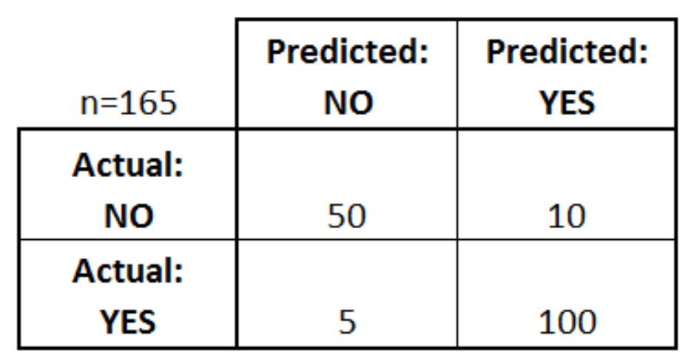
Model evaluation: the confusion matrix

Slide 13
Introduction to ML with R workshop
Install R studio
The environment: scripts, console, global environment
Script
Help
Install packages
Read csv (check dimensions, structure, summary)
Other resources (cheat sheets, tidyverse, caret)
Split data into train and test
Apply different classification algorithms
Evaluate model performance

Slide 14
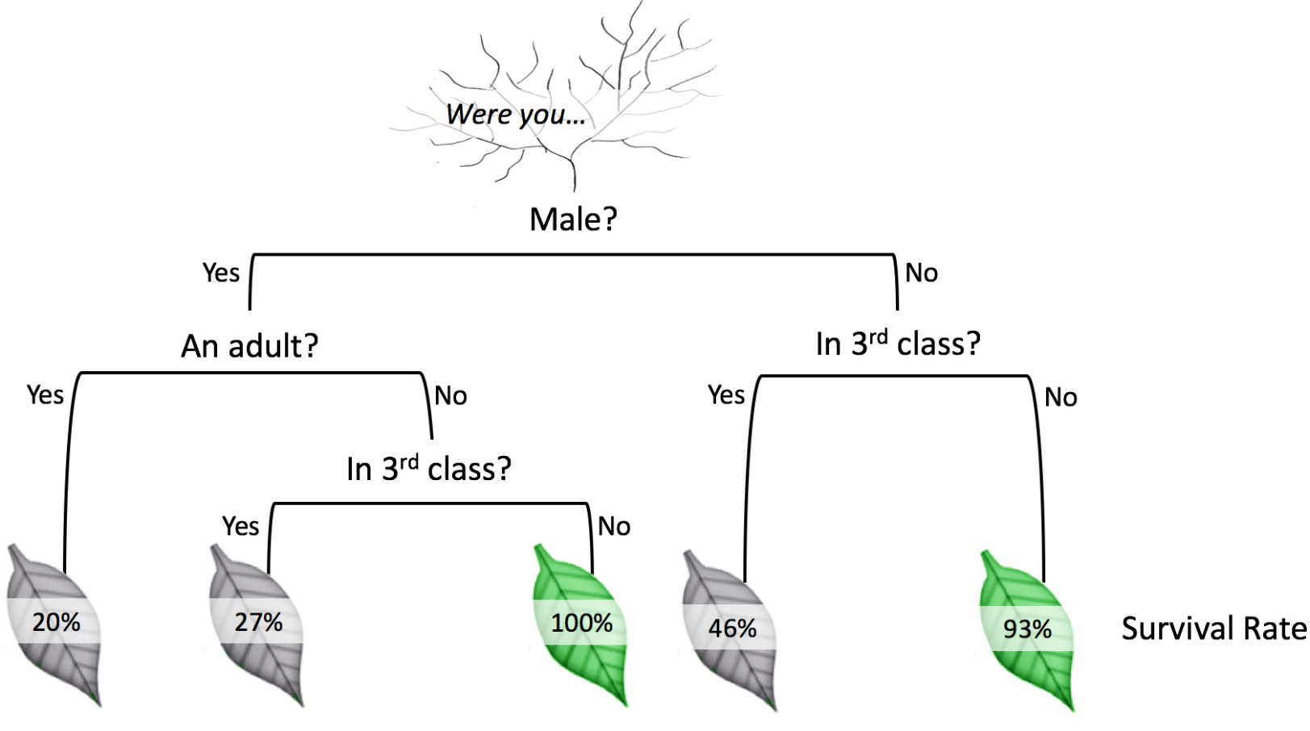
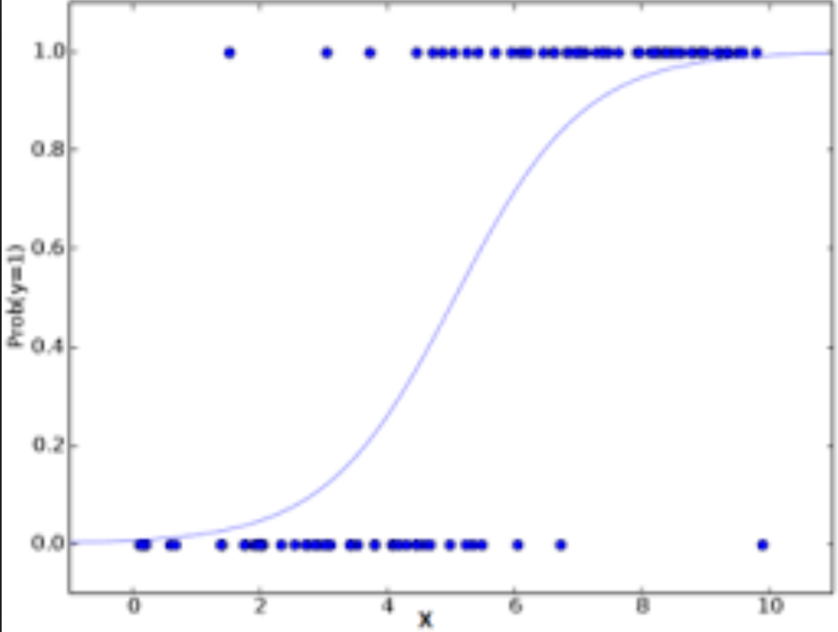
GLM and Decision Tree

Slide 15
References/useful resources
Data camp introduction to machine learning
Machine learning mastery- practical machine learning problems
Types of machine learning
The caret package
Confusion matrix

